Slide 1







02 - 04 DECEMBER 2025
RIYADH EXHIBITION AND CONVENTION CENTER, MALHAM, SAUDI ARABIA
Living in the namespace: Stealthy persistence in Linux
0xmadvise – Jabr
ORGANISED BY:
IN ASSOCIATION WITH:

Slide 2
~# Whoami
Jabr AlOtaibi,
17-years old security researcher focused on the Linux kernel, browser engines, and low level in general.
Past-work: 5+CVEs, UxPlay, AirPlay, ChroomServers, etc.
…

Slide 3
~# Agenda
Motivation behind this technique
Linux namespaces 101
Unshare’ing to persist
Live Demo
Conclusion

Slide 4
~# Motivation behind this technique
In most Linux systems, maintaining long-term access traditionally relies on creating startup entries like systemd services, cron jobs, or adding commands to shell configuration files.
Yes they’re effective but…
They’re Noisy
Actions get logged
Conventional and leaves artifacts

Slide 5
~# Stealth is required
For successful operations stealth is a crucial thing, and what we need is a way to stay alive on a system without leaving “obvious” traces, no extra files no reboots etc…
Modern Linux offers built-in primitives, like namespaces that allow processes to operate in an isolated environment, while still running on the same kernel.

Slide 6
~# Linux namespaces 101

Slide 7
~# Understanding Linux namespaces
To understand the technique, we first need to understand how namespaces work.
Linux namespaces are a kernel-level feature that allow processes to see isolated views of system resources, each namespace has a type such as PID, mount points, network interfaces, IPC objects and so on.
This isolation is the foundation of modern containers like Docker, Kubernetes and system-nspawn, as well as sandboxed envs.

Slide 8
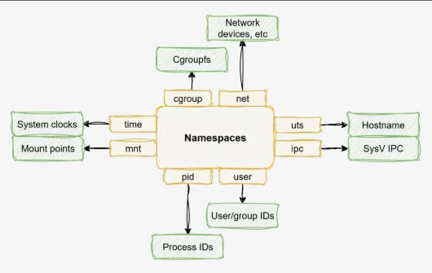
~# Understanding Linux namespaces .2
Pid = process ids
Net = network interfaces
Mnt = mount points and fs
Uts = hostname/domain name
Ipc = inter-process comms
User = UID/GID maps
CGROUPS = Cgroup hierarchies

Slide 9
~# Unshare’ing to persist

Slide 10
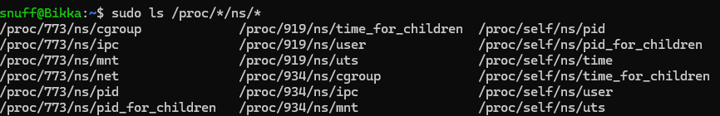
"]]}
~# Unshare’ing to persist
The core idea is to maintain a hidden presence on a Linux system without leaving obvious traces. Instead of creating services, modifying startup or even rebooting the host, we leverage existing linux namespaces to operate in an isolated environments.
The code first scans for accessible namespaces to join in “/proc*/ns/*”

Slide 11
"]]}
~# Unshare’ing to persist .2
And by joining these namespaces the process can “piggyback” on existing workloads and run silently alongside normal system activity, effectively hiding in plain sight.
Once inside a namespace, the program creates its own user namespace and maps itself as root, gaining full control of the process, mount points and network interfaces within that namespace, the it detaches itself and daemonizes itself.

Slide 12
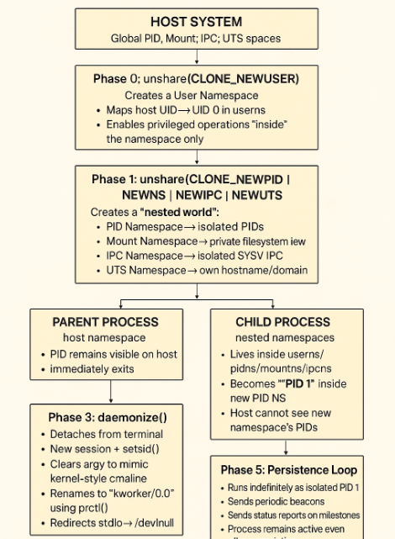
~# Live demo

Slide 13
"]]}
~# Defending against this
Defending against a fully weaponized version of this technique is difficult but not impossible.
To defend against this technique, sysadmins can enforce strict namespace isolation and access controls, limit which users can join or create namespaces and monitor /proc/ for unusual activities.
And also. sysctl –w kernel.unprivileged_userns_clone=0
Which is used to control whether unprivilieged users can create new user namespaces or not.

Slide 14
~# Finishing up

Slide 15
"]]}
~# Finishing up
Linux namespaces provide powerful primitives for isolation and stealth.
This approach avoids traditional noisy persistence mechabisms like system and cron jobs, making it extremely difficult to detect and mitigate.
Namespaces are not just for containers-they can be leveraged for advanced persistence and stealth on modern linux systems. Defenders must be aware of the risks, and monitor namespace usage and enforce strict rules.

Slide 16
~# Thank you for listening!

